Slide 1


Train Kinematics Simulation with Real-World Data: Trajectory Data Generation
Authors:
Andrea Vivai
Enea Dragoni
Supervisors:
Giorgio Buttazzo
Federico Nesti
Scuola Superiore Sant’Anna

Slide 2
Steps:
1. Used OpenStreetMaps (OSM) to extract railway tracks and maximum speed data.
2. Calculated the desired speed profile while including maximum acceleration and jerk constraints.
3. Modeled the train with a double carriage dynamic system, obtaining positions velocities, accelerations, orientation, and angular velocity ground-truth data.
4. Simulated IMU readings (accelerometer and gyroscope) based on the ground-truth values.
Scuola Superiore Sant’Anna

Slide 3
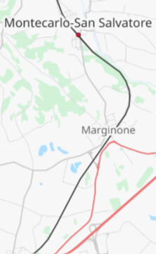
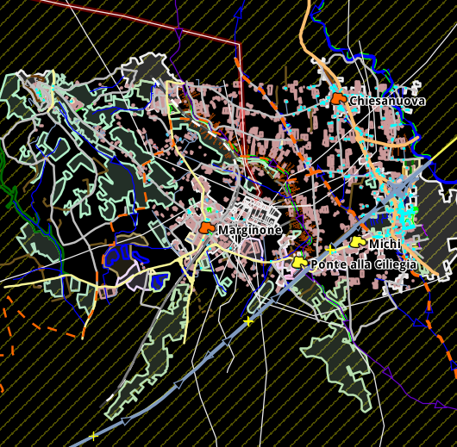
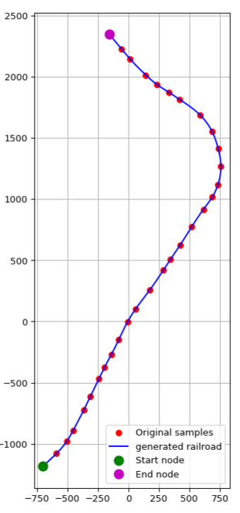

Railroad Generation:
Choosed the desired area
Parsed the corresponding XML file
Generated the railroad
https://www.openstreetmap.org.
Scuola Superiore Sant’Anna

Slide 4
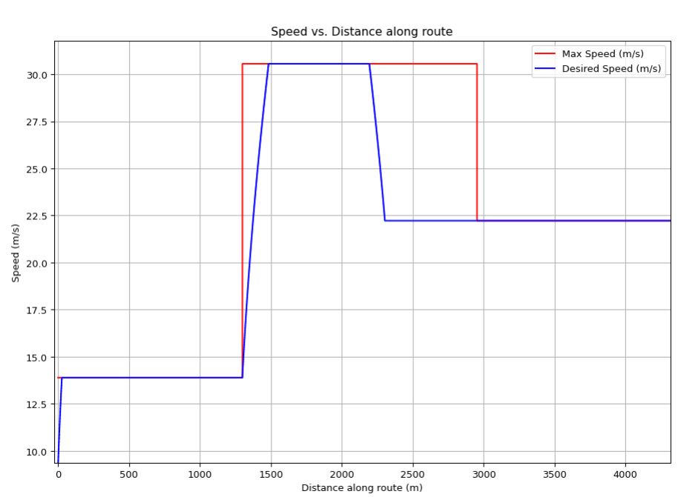
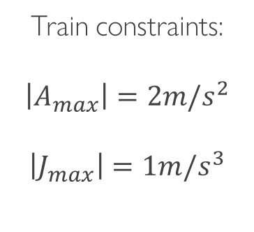
Desired speed setpoint:
Train constraints:
$$\left|A_{max}\right|=2m/s^{2}$$
$$\left|J_{max}\right|=1m/s^{3}$$
In the real world, train dynamics follow a desired speed profile created by a human, not the maximum speed profile. The profile generator also provides safety margins by decelerating automatically beforehand to compensate for any train delays.
Scuola Superiore Sant’Anna

Slide 5
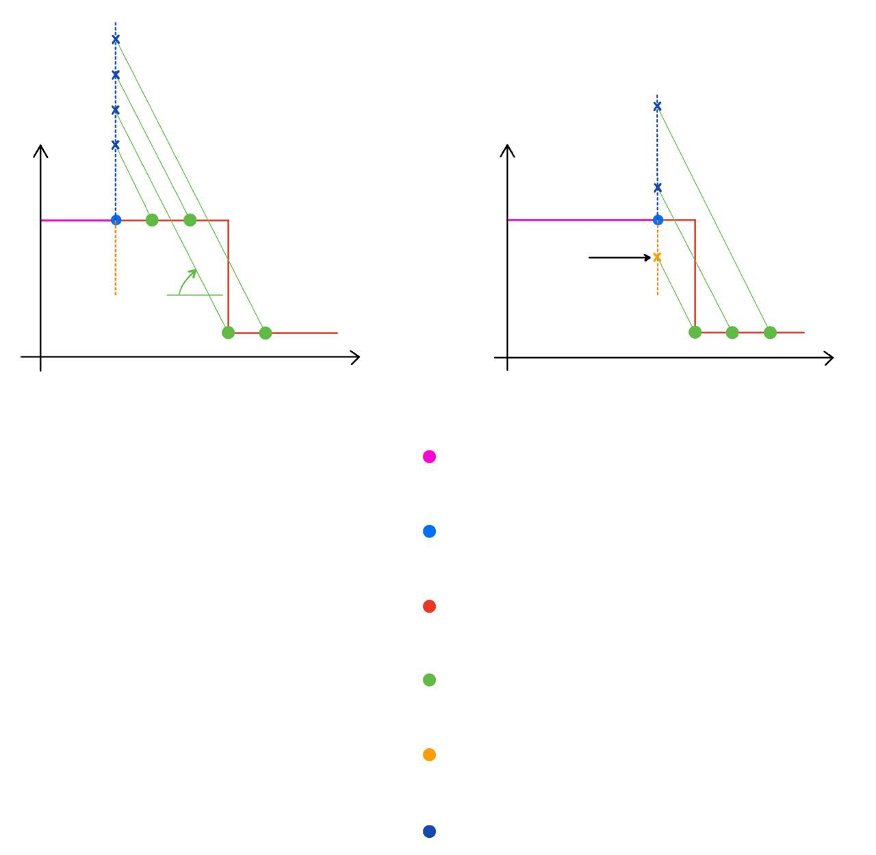
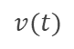

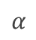
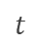
How to know when to decelerate?
$$α=2m/s^{2}$$
There are many ideas, to see the full explanation see the documentation in the notebook.
$$v(t)$$
$$v(t)$$
$$α$$
As example, consider these 2 situations:
$$t$$
$$t$$
Calculate the intersection (x, x) between the vertical line passing through the current maximum speed and the line with a deceleration of 2 m/s² passing through the considered speed point.
Set the current speed limit to be the minimum between the current maximum speed and the intersection point with the minimum value (in this specific case, the current speed coincide with the current maximum speed).
If the current speed limit is less than the current speed, the velocity will be decreased. The check is repeated for many points forward
PAST MAX SPEED
CURRENT MAX SPEED
FUTURE MAX SPEED
FUTURE SPEED CHECK
NEED TO DECELERATE
DON’T NEED TO DECELERATE
Scuola Superiore Sant’Anna

Slide 6
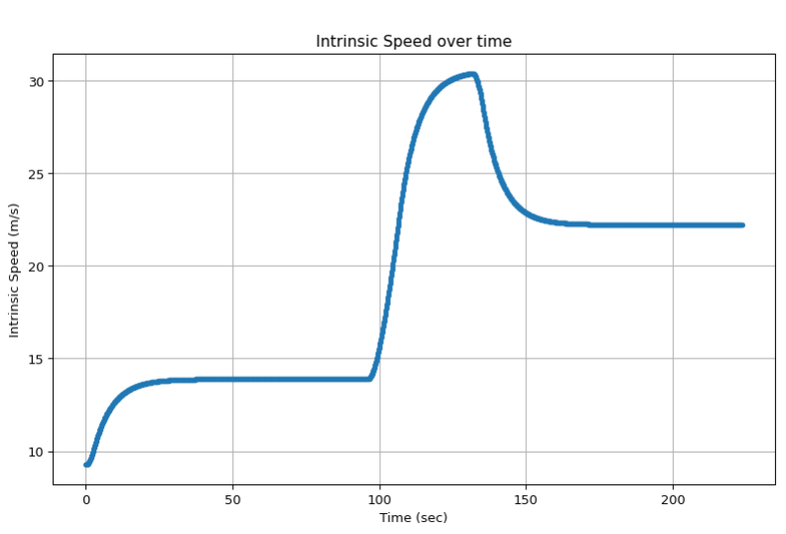
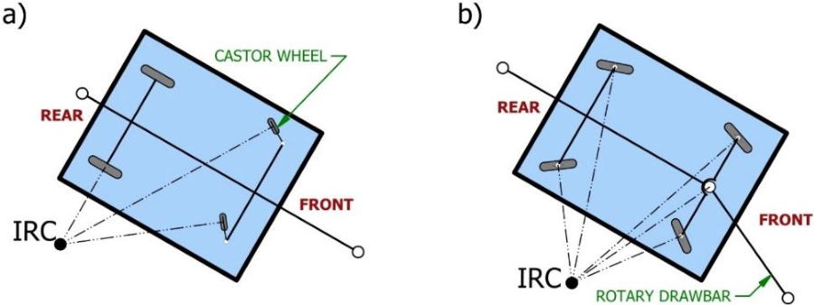
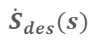


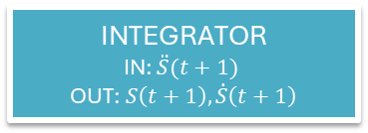
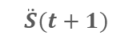

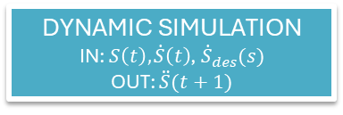
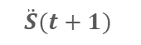
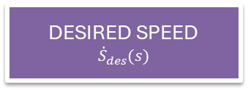

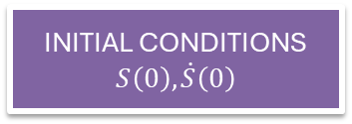
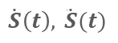
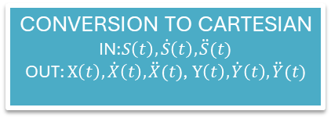
Train simulation scheme:
CONVERSION TO CARTESIAN
IN:$S\left(t\right), \dot{S}\left(t\right), \ddot{S}(t)$
OUT: $X\left(t\right), \dot{X}\left(t\right), \ddot{X}(t)$, $Y\left(t\right), \dot{Y}\left(t\right), \ddot{Y}(t)$
plot
$$S\left(t\right), \dot{S}\left(t\right),\ddot{S}(t)$$
INITIAL CONDITIONS
$$S\left(0\right), \dot{S}\left(0\right)$$
$$S\left(0\right), \dot{ S}\left(0\right)$$
TRAIN STATE
$$S\left(t\right), \dot{S}\left(t\right),\ddot{S}(t)$$
$$S\left(t+1\right), \dot{ S}\left(t+1\right)$$
INTEGRATOR
IN: $\ddot{S}(t+1)$
OUT:$S\left(t+1\right), \dot{S}\left(t+1\right)$
$$\dot{S}\left(t\right), \ddot{ S}(t)$$
$$\ddot{S}(t+1)$$
DESIRED SPEED
$${\dot{S}}_{des}(s)$$
$${\dot{S}}_{des}(s)$$
DYNAMIC SIMULATION
IN: $S\left(t\right), \dot{S}\left(t\right)$, ${\dot{S}}_{des}(s)$
OUT: $\ddot{S}(t+1)$
$$\ddot{S}(t+1)$$
Scuola Superiore Sant’Anna

Slide 7
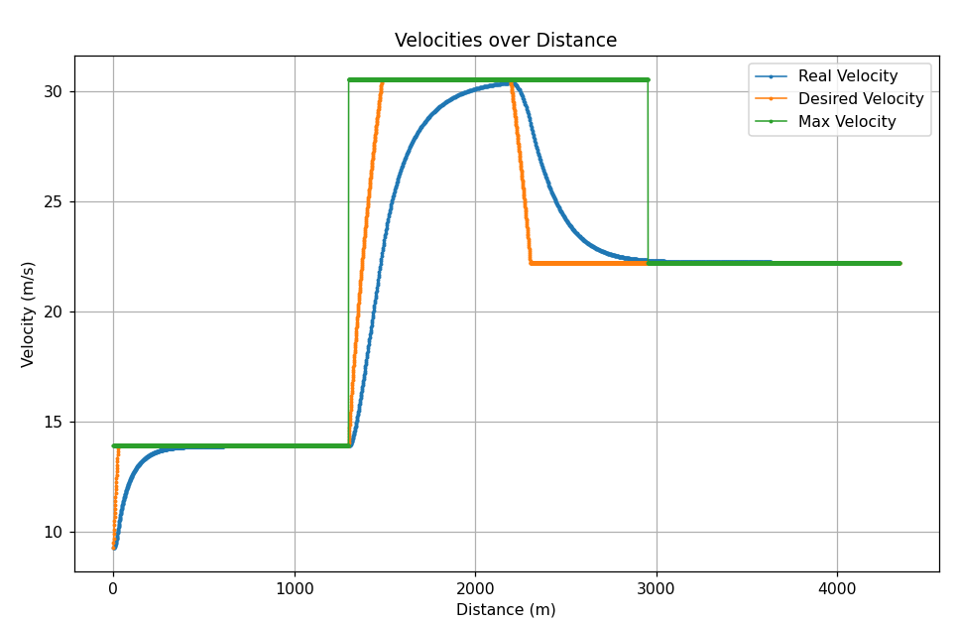
Dynamic Behaviour of the Train:
Scuola Superiore Sant’Anna

Slide 8
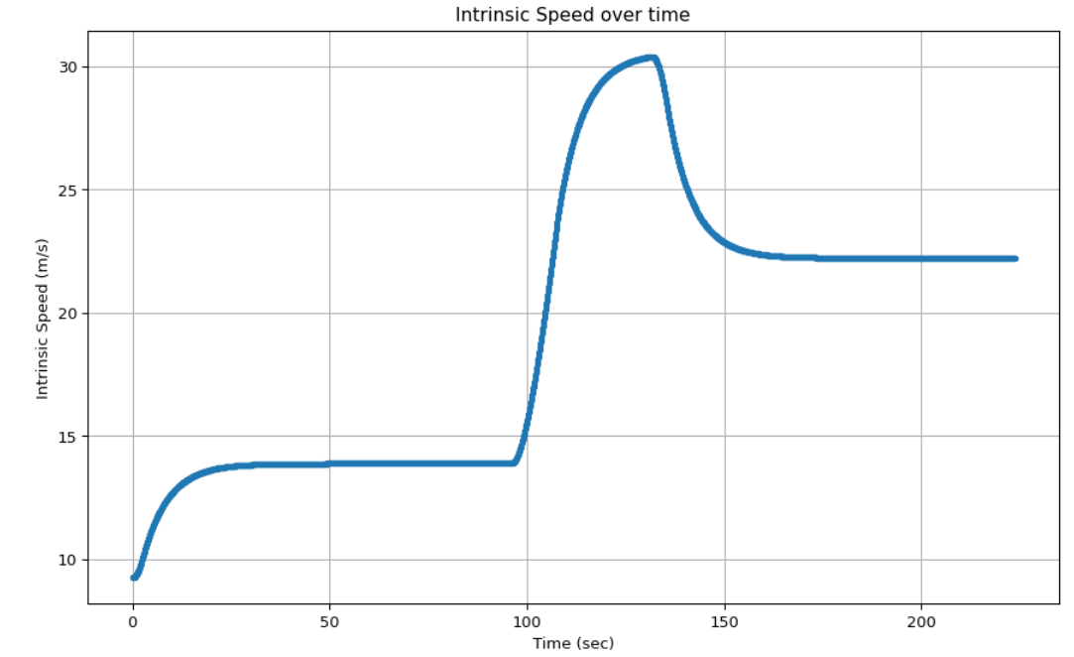
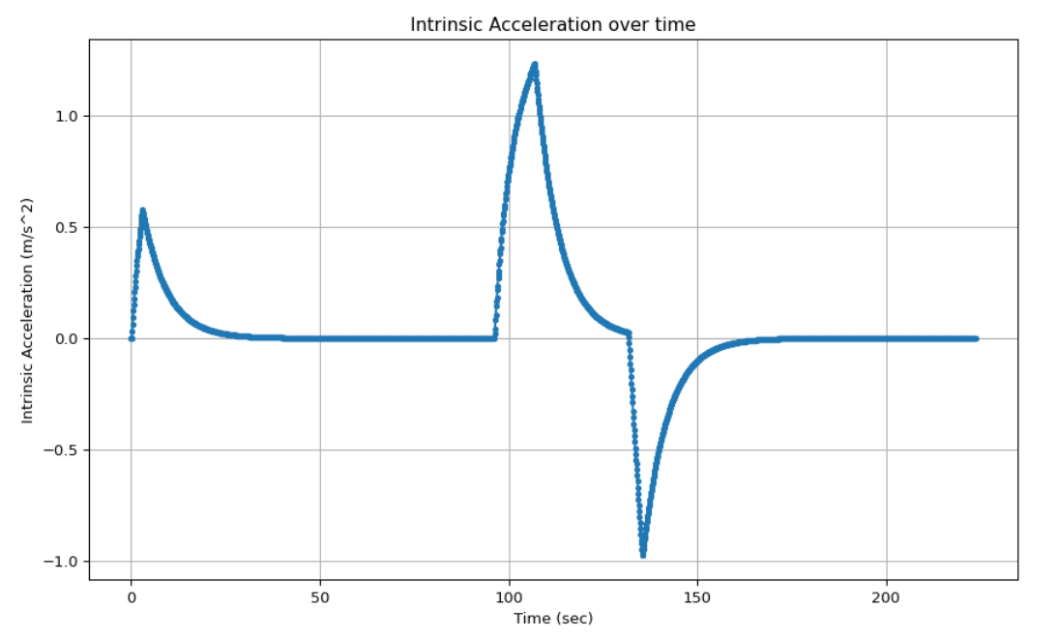
Intrinsic Data - Front Bogie
Scuola Superiore Sant’Anna

Slide 9
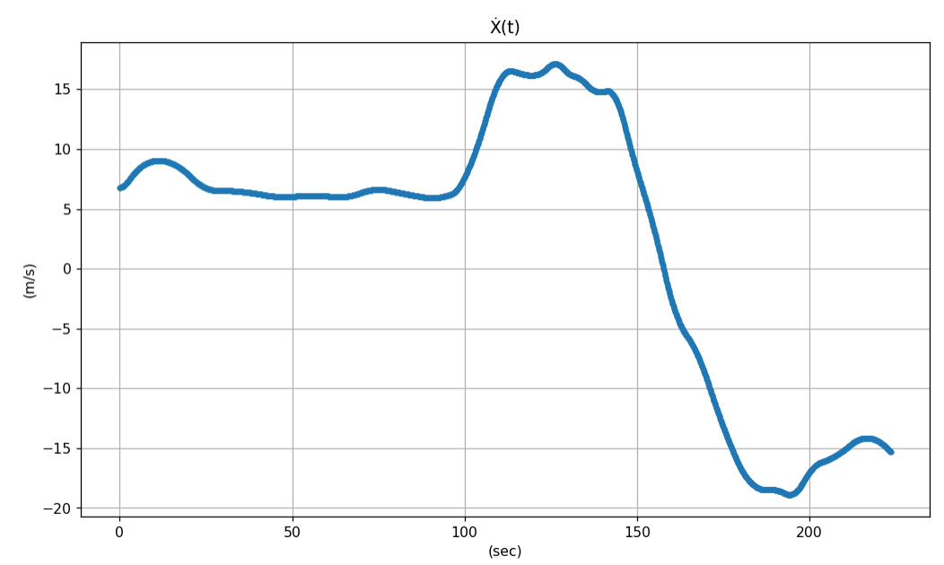
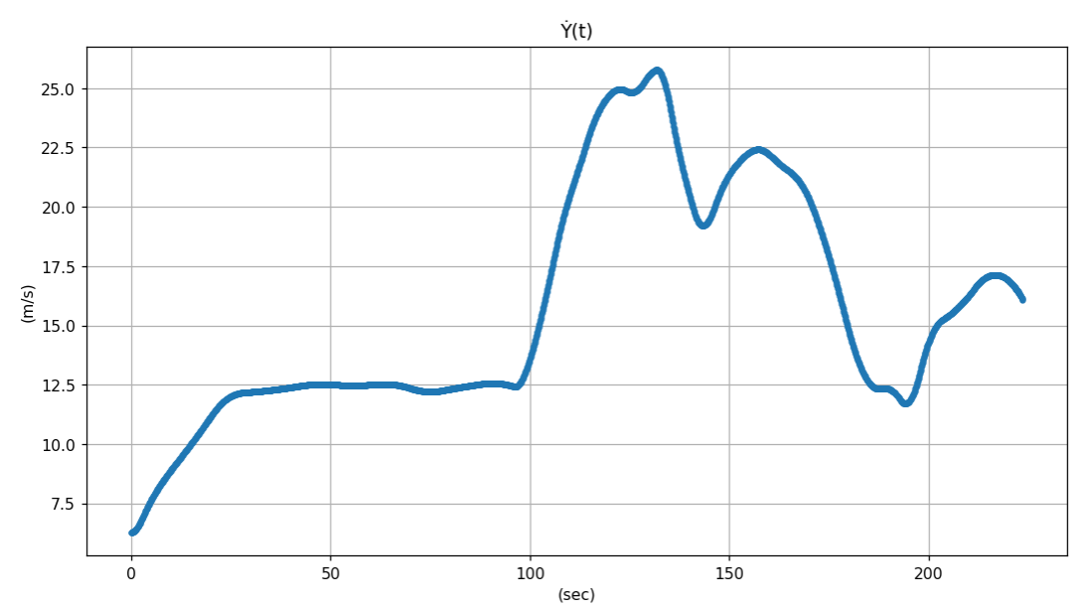
Cartesian Data - Front Bogie
Scuola Superiore Sant’Anna

Slide 10
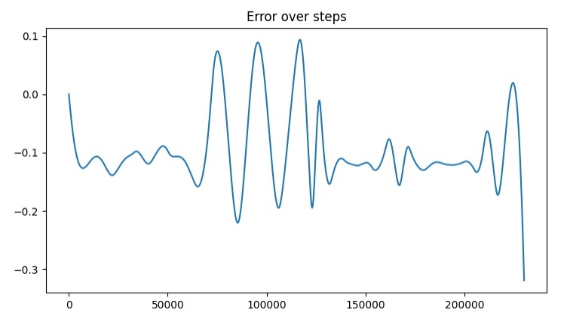
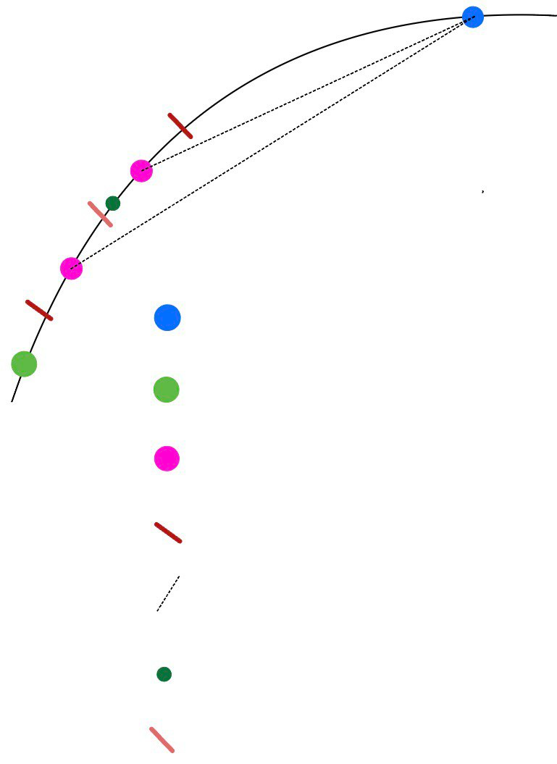
How to model the back bogie kinematics?
m
One simple way would be to assume the same speed module for both the front and the back bogie, but this would cause errors during curves, as shown here:
To eliminate this error, the following algorithm was implemented:
Starting from the current position of the front bogie and the past position of the back bogie, we assume an advancement upper and lower bound for the back bogie, defining a railroad section.
The chosen railroad section is iteratively halved, and the distance between the centroid of each half and the front bogie position is calculated: the distance closer to the real cart length is chosen to be halved again until a stop criterion is met, and the centroid of the current section is returned as the back bogie position.
The algorithm is then repeated with a new front bogie position.
CURRENT FRONT POSITION
PAST BACK POSITION
CURRENT BACK POSITION GUESS
BACK POSITION GUESS BOUND
CALCULATED DISTANCE
CURRENT BACK POS. (UNKNOWN)
HALF BOUND SECTION
Scuola Superiore Sant’Anna

Slide 11
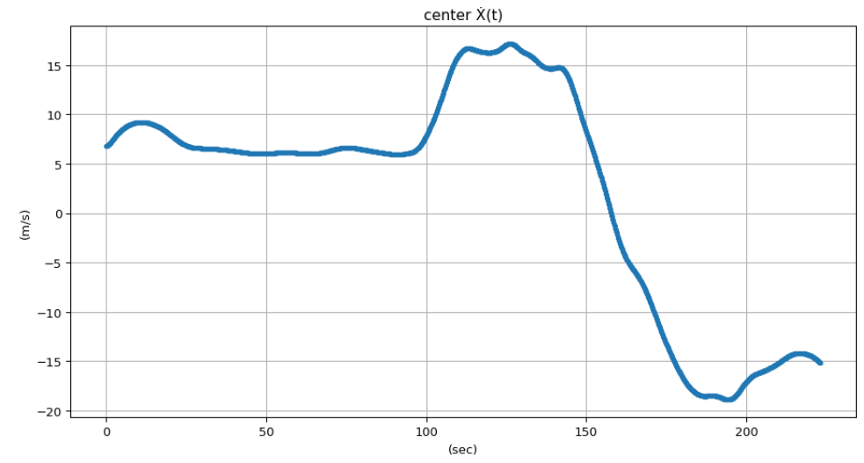
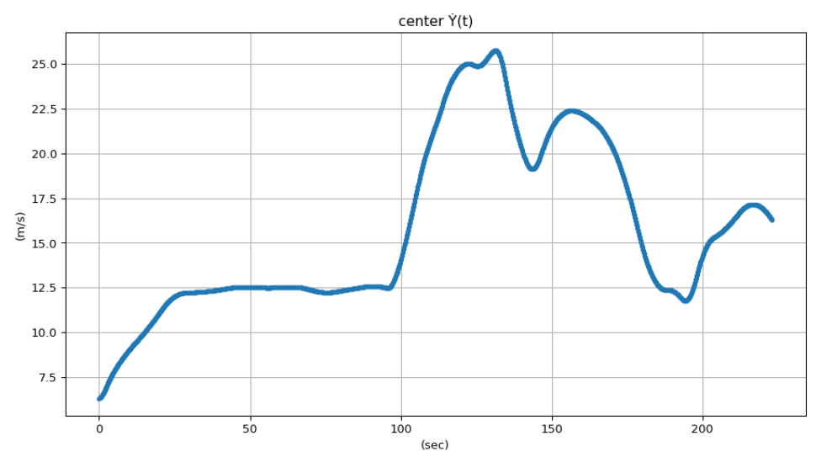
Cartesian Data - Cart Center
Scuola Superiore Sant’Anna

Slide 12
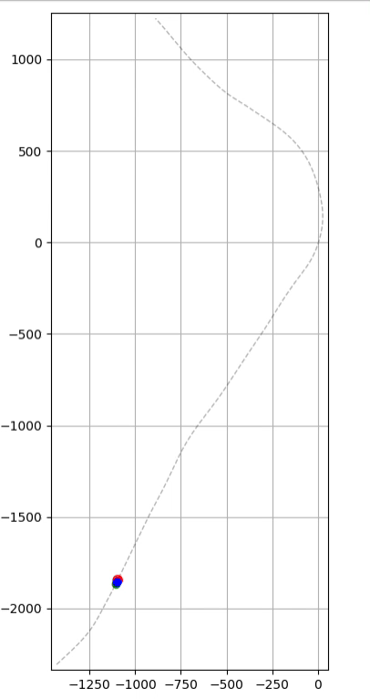
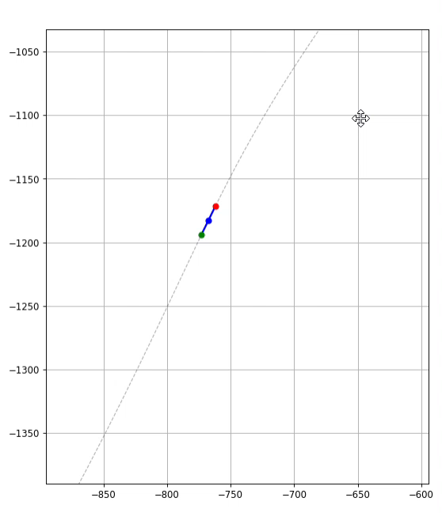
Train Animations
Scuola Superiore Sant’Anna

